Slide 1
Data Structures and Algorithms
Dr. N. L. Bhanu Murthy
Computer Science & Information Systems Department

Slide 2
Lower Bound on Sorting Algorithms (comp based)
What is the best we can do on comparison based sorting?
Best worst-case sorting algorithm (so far) is O(N log N)
Can we do better (or) Can we prove a lower bound on the sorting problem, independent of the algorithm?
For comparison sorting, we can show lower bound of Ω(N log N)

Slide 3
Decision Tree for Sorting Algorithms
A decision tree is a binary tree where:
  Each node
    lists all left-out open possibilities (for deciding)
  Path of each node
    represents a decided sorted prefix of elements
  Each branch
    represents an outcome of a particular comparison
  Each leaf
    represents a particular ordering of the original array elements

Slide 4
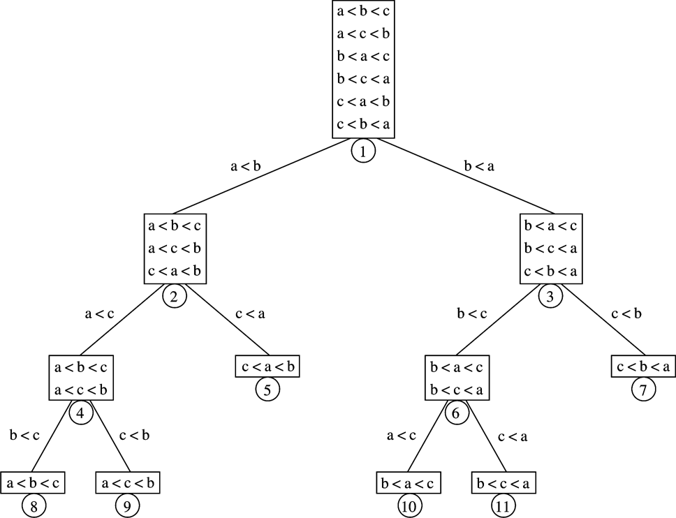
Root = all open possibilities
IF a<b:
possible
A decision tree to sort three elements {a,b,c}
(assuming no duplicates)
Height =
Ω(lg n!)
all remaining open possibilities
IF a<c:
possible
Worst-case
evaluation path
for any algorithm
n! leaves
in this tree
Notes:
Cpt S 223
Washington State University

Slide 5
Decision-tree example
Sort ⟨a₁, a₂, …, a_{n}⟩
1:2
2:3
1:3
123
1:3
213
2:3
132
312
231
321
Each internal node is labeled i:j for i, j ∈ {1, 2,…, n}.
The left subtree shows subsequent comparisons if a_{i} ≤ a_{j}.
The right subtree shows subsequent comparisons if a_{i} ≥ a_{j}.

Slide 6
Decision-tree example
Sort ⟨a₁, a₂, a₃⟩ = ⟨ 9, 4, 6 ⟩:
1:2
9 ≥ 4
2:3
1:3
123
1:3
213
2:3
132
312
231
321
Each internal node is labeled i:j for i, j ∈ {1, 2,…, n}.
The left subtree shows subsequent comparisons if a_{i} ≤ a_{j}.
The right subtree shows subsequent comparisons if a_{i} ≥ a_{j}.

Slide 7
Decision-tree example
Sort ⟨a₁, a₂, a₃⟩ = ⟨ 9, 4, 6 ⟩:
1:2
2:3
1:3
9 ≥ 6
123
1:3
213
2:3
132
312
231
321
Each internal node is labeled i:j for i, j ∈ {1, 2,…, n}.
The left subtree shows subsequent comparisons if a_{i} ≤ a_{j}.
The right subtree shows subsequent comparisons if a_{i} ≥ a_{j}.

Slide 8
Decision-tree example
Sort ⟨a₁, a₂, a₃⟩ = ⟨ 9, 4, 6 ⟩:
1:2
2:3
1:3
123
1:3
213
2:3
4 ≤ 6
132
312
231
321
Each internal node is labeled i:j for i, j ∈ {1, 2,…, n}.
The left subtree shows subsequent comparisons if a_{i} ≤ a_{j}.
The right subtree shows subsequent comparisons if a_{i} ≥ a_{j}.

Slide 9
Decision-tree example
Sort ⟨a₁, a₂, a₃⟩ = ⟨ 9, 4, 6 ⟩:
1:2
2:3
1:3
123
1:3
213
2:3
132
312
231
321
4 ≤ 6 ≤ 9
Each leaf contains a permutation ⟨π(1), π(2),…, π(n)⟩ to indicate that the ordering a_{π(1)} ≤ a_{π(2)} ≤ ☹ ≤ a_{π(n)} has been established.

Slide 10
Decision Tree for Sorting Algorithms
The logic of any sorting algorithm that uses comparisons can be represented by a decision tree
In the worst case, the number of comparisons used by the algorithm equals the HEIGHT OF THE DECISION TREE
In the average case, the number of comparisons is the average of the depths of all leaves
There are N! different orderings of N elements

Slide 11
Lower bound for decision-tree sorting
Theorem. Any decision tree that can sort n elements must have height Ω(n lg n) .
Proof. The tree must contain ≥ n! leaves, since there are n! possible permutations.
A height-h binary tree has ≤ 2^{h} leaves.
Thus, n! ≤ 2^{h} .
∴h ≥ lg(n!) (lg is mono. increasing)
≥ lg ((n/e)^{n}) (Stirling’s formula)
= n lg n – n lg e
= Ω(n lg n) .
since n lg n – n lg e >= 1/2 n lg n for all n >= n₀ (take n₀ to be 100)

Slide 12


Problem Complexity
if
if

Slide 13
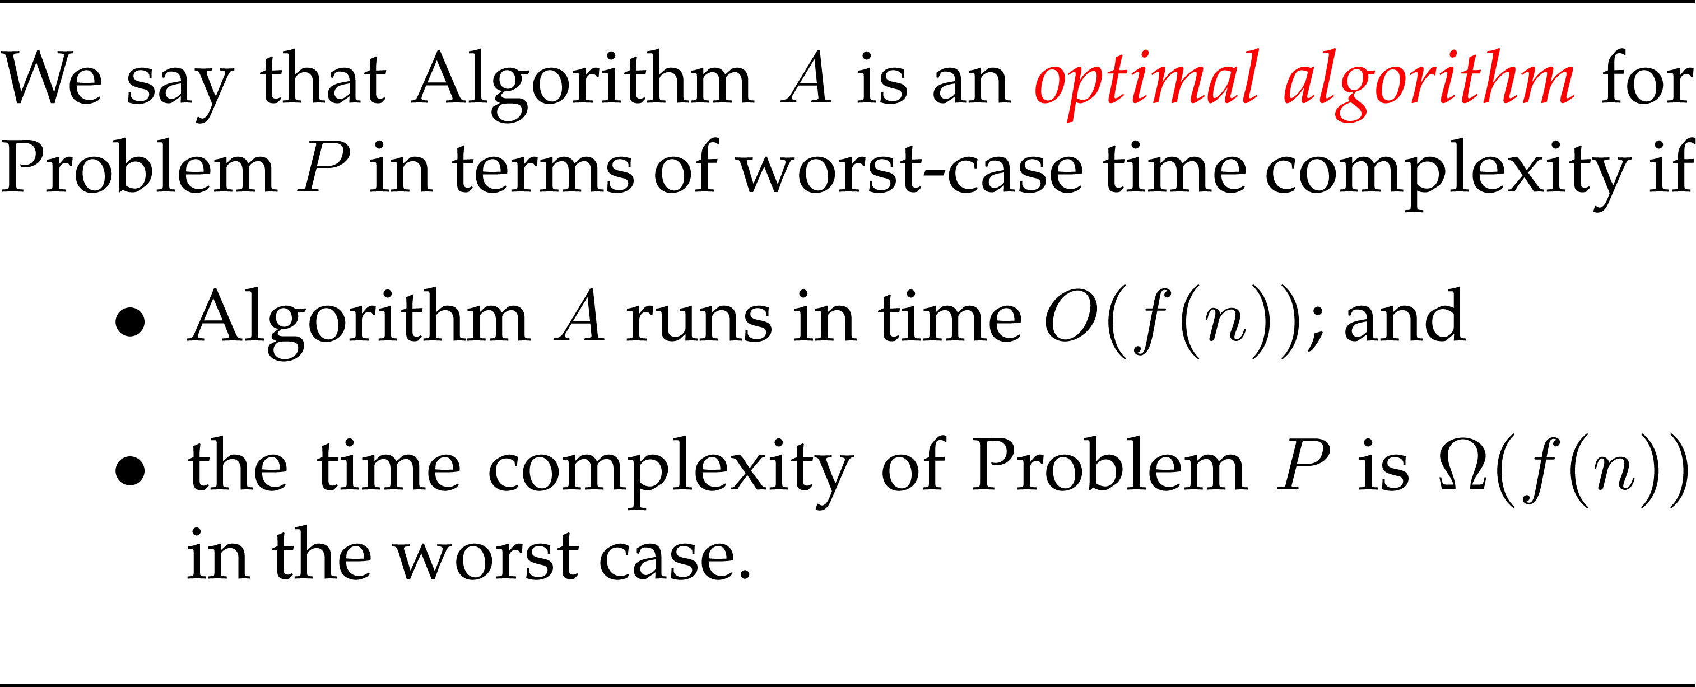
Optimal Algorithm
Corollary. Merge sort and Heap Sort are asymptotically optimal comparison sorting algorithms.

Slide 14
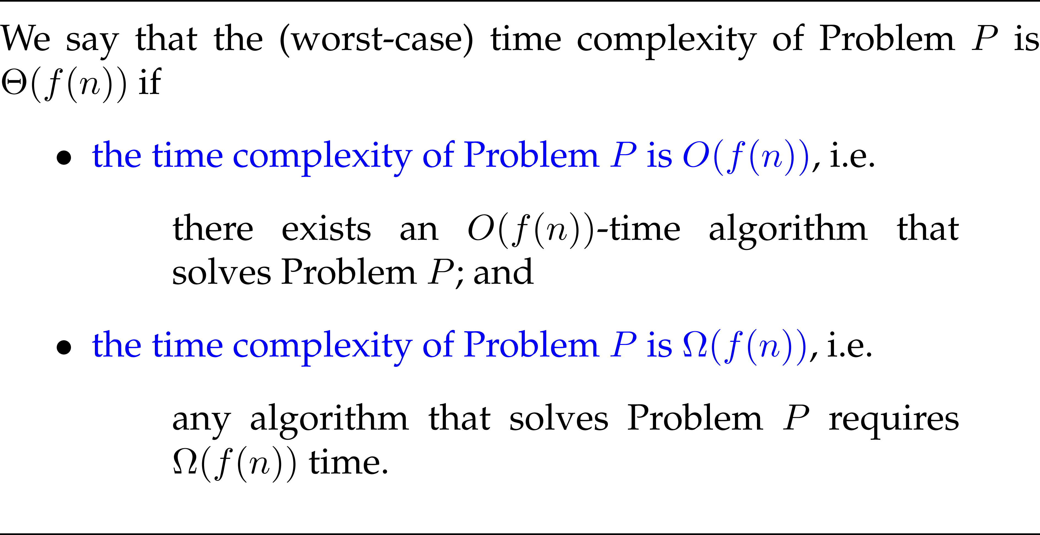

Slide 15

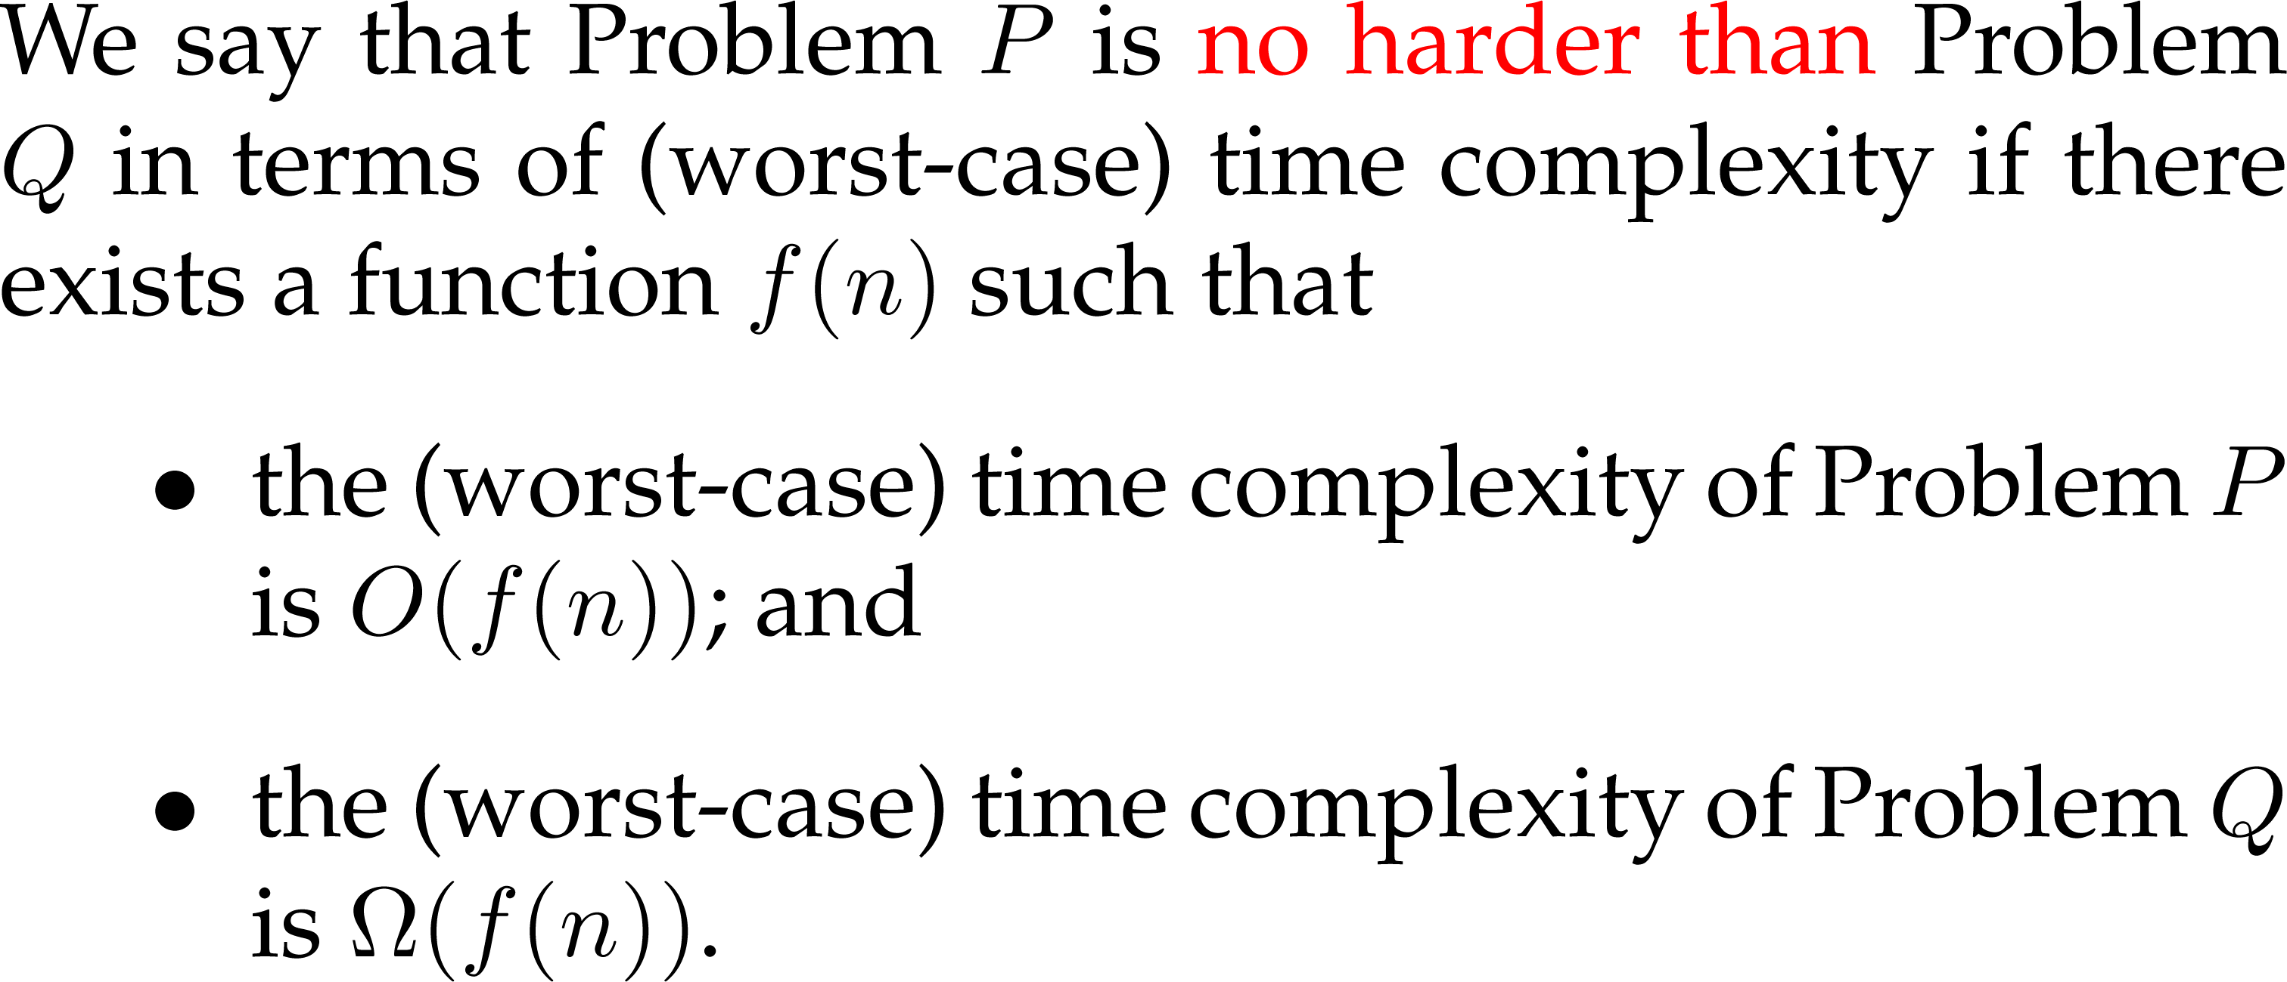
Comparing P and Q

Slide 16

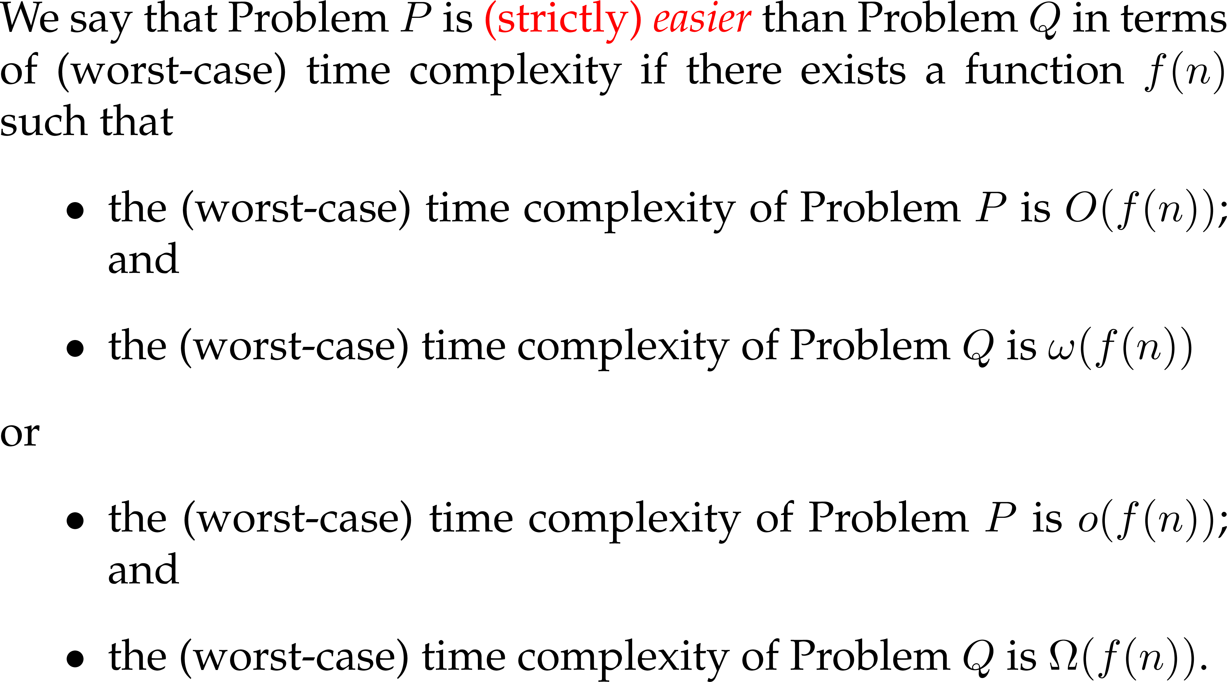
Comparing P and Q

Slide 17
Thank You!!

